Slide 1
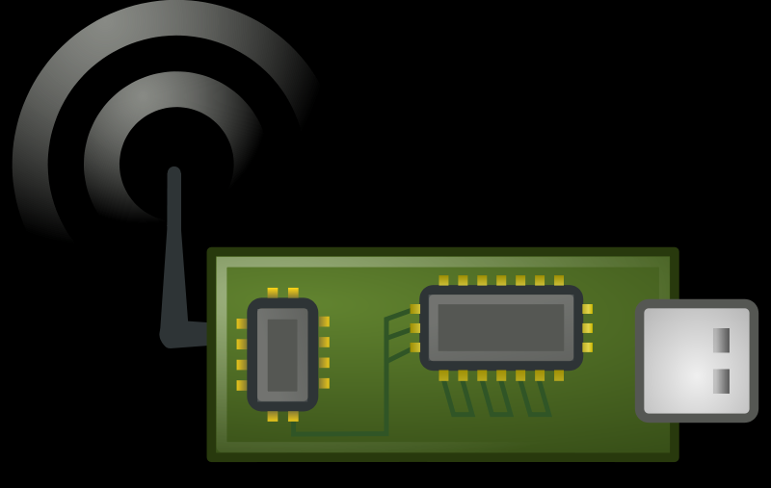
Sensors
Protocol
Broker
Database
Visualization
Telegraf
Influx
UofU Server
Web Browser
MQTT Publish
MQTT Subscribe
Google Web Server

Slide 2
Sensors
Protocol
Cloud Service
IoT to DB Broker
Database
Visualization
Google
Cloud Function
(Node.js)
Google
Big Query
Google Data Studios
IoT Core
MQTT Publish
MQTT Subscribe

Slide 3
Sensors
Protocol
Cloud Service
IoT to DB Broker
Database
Visualization
Cloud Function
(Node.js)
Cloud-based DB
Cloud-based Visualization
IoT Cloud Connection
MQTT Publish
MQTT Subscribe

